Slide 1
Airbnb- An Exploratory Data Analysis (Canada Region)
A Project by Raj, Suhas and Vijay

Slide 2

Airbnb History
The site Airbedandbreakfast.com officially was launched on August 11, 2008 by Brian Chesky, Joe Gebbia and Nathan Blecharczyk
Airbnb, Inc. is an online marketplace for arranging or offering lodging, primarily homestays, or tourism experiences. The company does not own any of the real estate listings, nor does it host events; it acts as a broker, receiving commissions from each booking. The company is headquartered in San Francisco, California, United States.
Airbnb's success is not dependent on Tourists but also on Business Travellers seeking short term rentals.

Slide 3

Core Hypothesis
Looking to answer a few questions like:
How Airbnb has grown in Canada over the years
Which province has more listings and is more expensive
How is the price impacted by the accommodation type that a Guest chooses
What factors would increase the rating as a Host
Which is the best neighbourhood in each province(based on Number of listings, Price, Number of reviews, Ratings) to book an Airbnb.
In which province customers are most likely to leave reviews and for what property types

Slide 4

Overview of Data
Collected the dataset from https://public.opendatasoft.com/
Sample of 30K+ properties across Canada
Listing ID, Coordinates, Room Type, Room Price, No. of reviews, Minimum Nights, Host Since (proxy for listing date) , Cancellation policy, Amenities, Host response rate etc
Based on the sample, Airbnbs are concentrated around major cities. Probably because of the no. of tourists visiting, ease of transportation, things to do among other reasons.

Slide 5
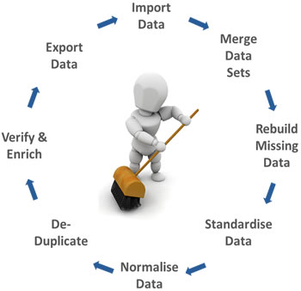
Data Cleansing
Dropped columns not required for the analysis, thereby reducing from 180 to 28 columns
Consolidated the province names into ON,BC and QC
Dropped the rows which had missing price values to make the data more meaningful.
Once cleansing was done we had 30692 data points.
Ignored the rows where ratings were not available for any analysis related to ratings

Slide 6

Data Manipulation
Total no. of listings, avg price and avg ratings for Canada and the respective provinces
Grouped by the room type for no. of listings, avg price, ratings and no. of people it accommodates for Canada and the respective provinces
Grouped by the year of listing to obtain no. of new listings every year across Canada and for each province
Grouped by the host response time to establish relation between the response time and the Avg ratings
Based on the mean and Quartiles of No. of listings, Avg Price, Avg reviews and avg ratings, established the best neighborhoods to rent in each province

Slide 7
Summary Analysis for Canada Region

Slide 8
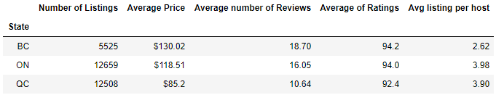
Province wise summary table

Slide 9
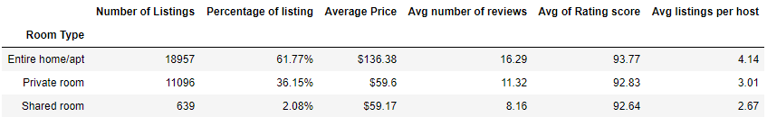
Summary stats based on Room type

Slide 10
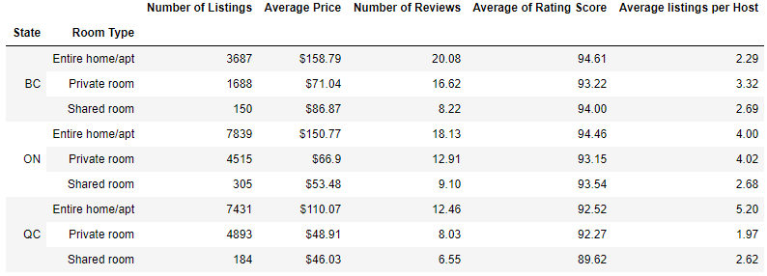
Province wise breakdown of Room type stats

Slide 11
Criteria to determine best neighbourhoods
Mean and quartiles for No. of listings, Avg. price, Avg. no of Reviews and Avg Ratings
No. of listings greater than the mean
Average price less than the upper quartile
Average no. of reviews greater than the mean
Average ratings greater than the mean

Slide 12
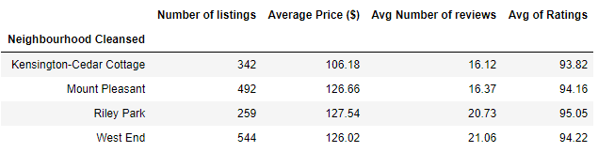
Best neighbourhoods in BC

Slide 13
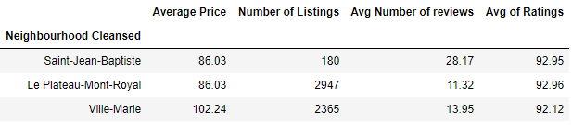
Best neighbourhoods in QC

Slide 14
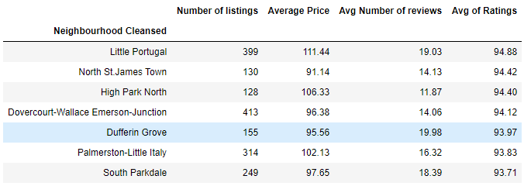
Best neighbourhoods in ON

Slide 15

Over to Raj

Slide 16
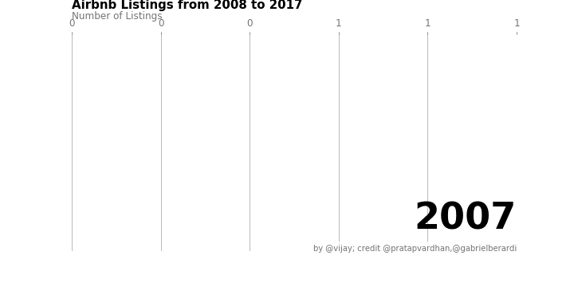
Animation showing the increase in listings from 2008 to 2017 in Canada

Slide 17
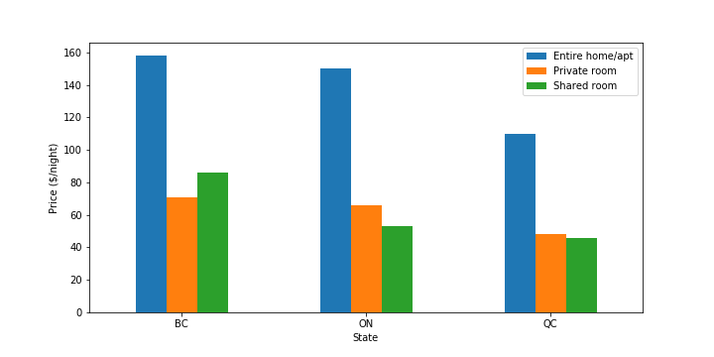
Price ($/night) vs Room Type across all 3 provinces

Slide 18
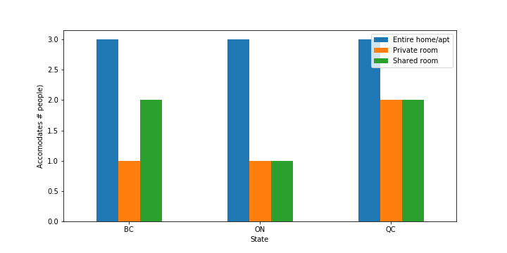
Room type vs Accommodates

Slide 19
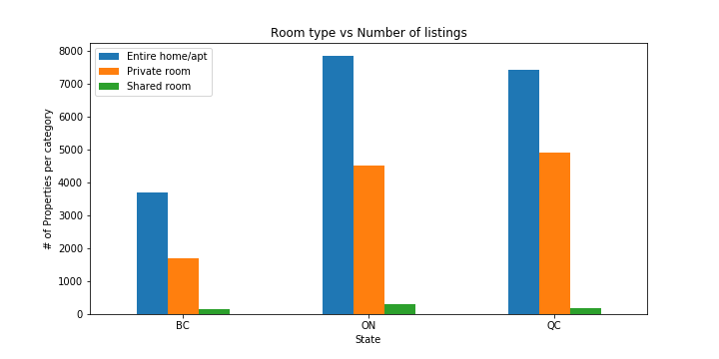
Room Type vs Number of Listings

Slide 20
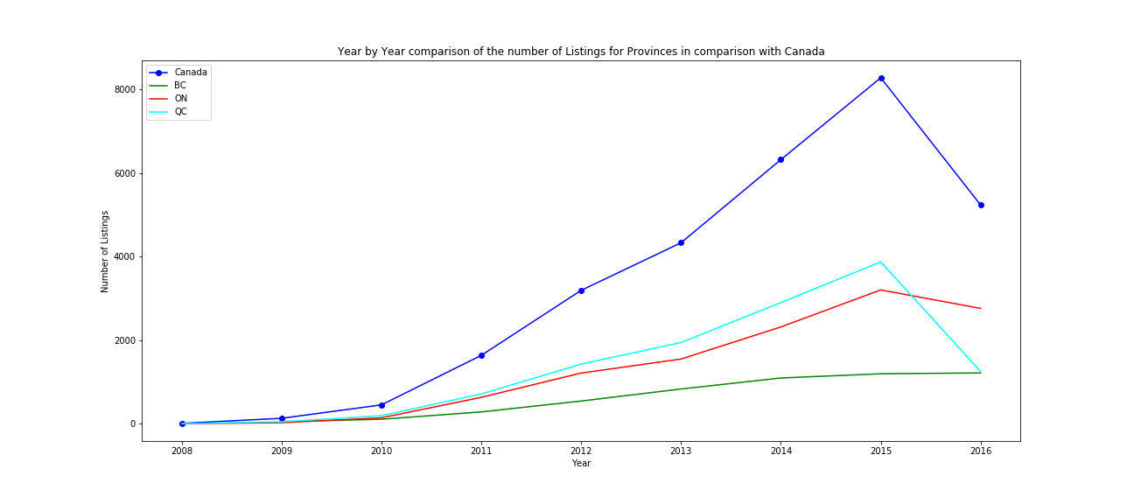
Both QC and ON took a hit in the number of listings from 2015 to 2016 probably due to new regulations being imposed by the respective provincial governments.

Slide 21
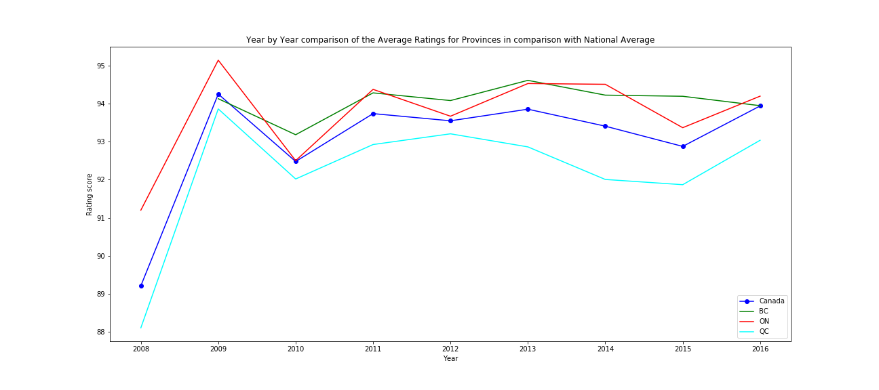
QC has a lower average rating per listing as compared to ON and BC.

Slide 22
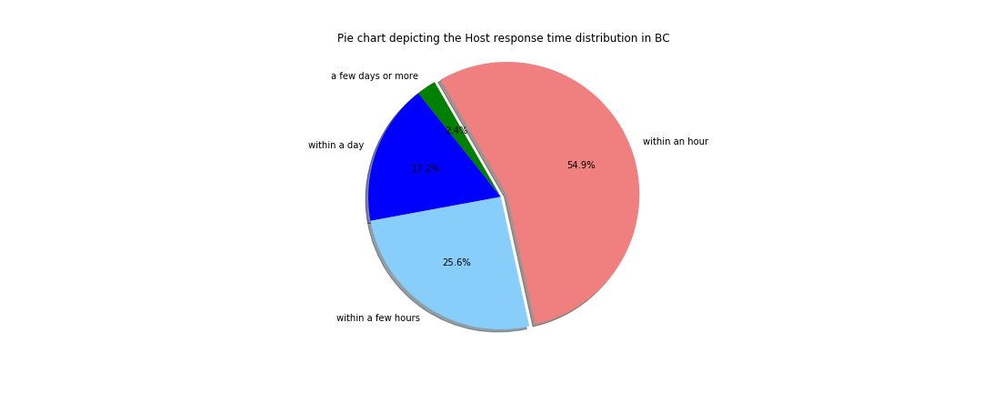
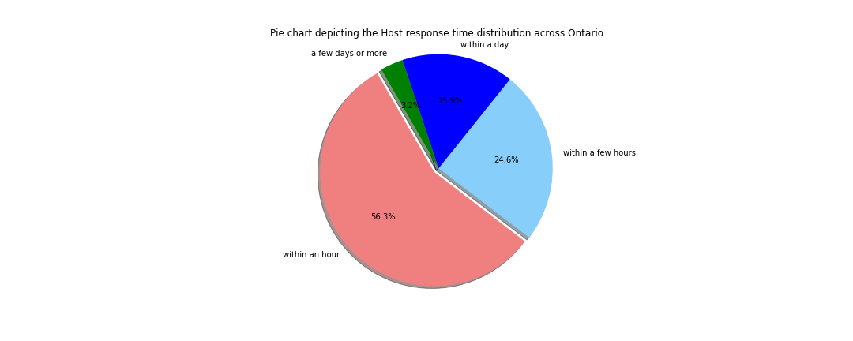
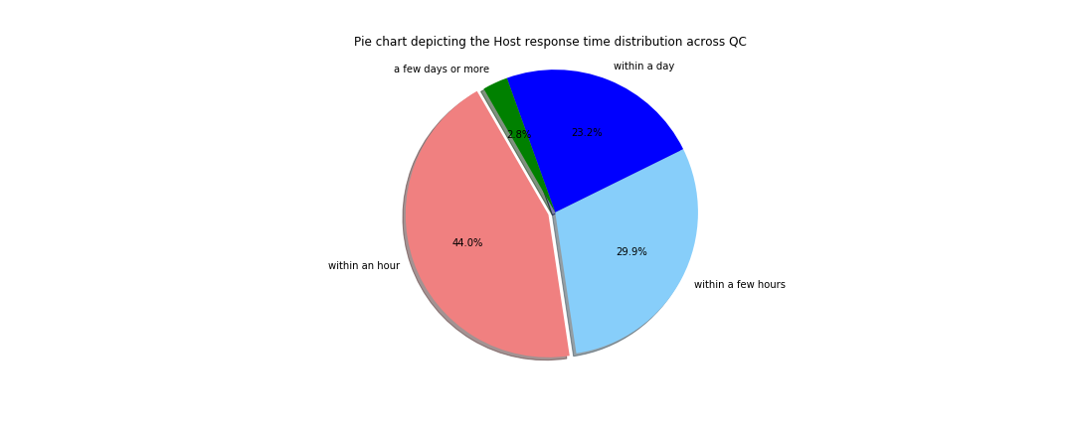
BC
ON
QC
Approximately 97% of the Hosts respond to Guests within a day.

Slide 23
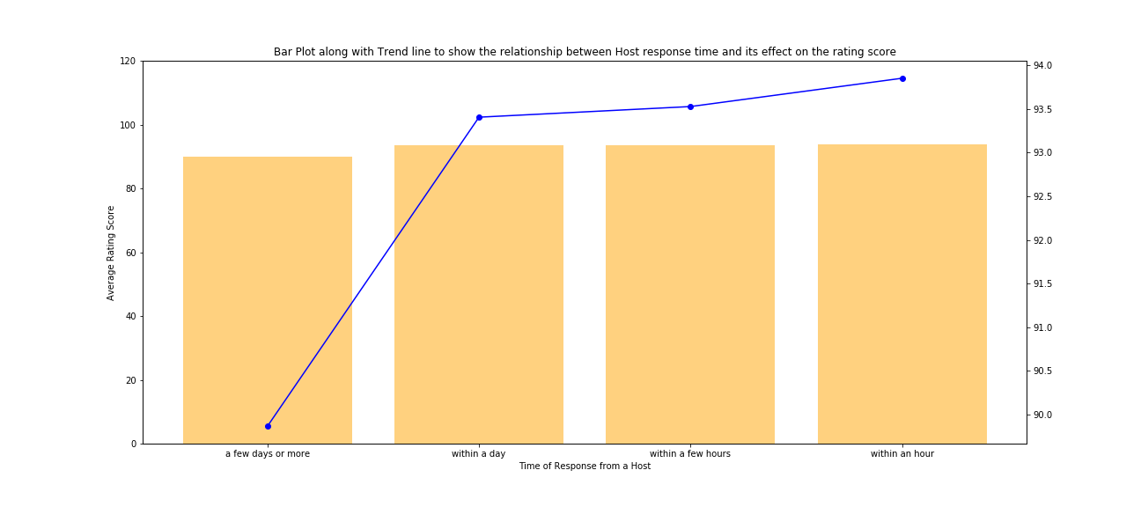
Lower response time leads to higher ratings

Slide 24
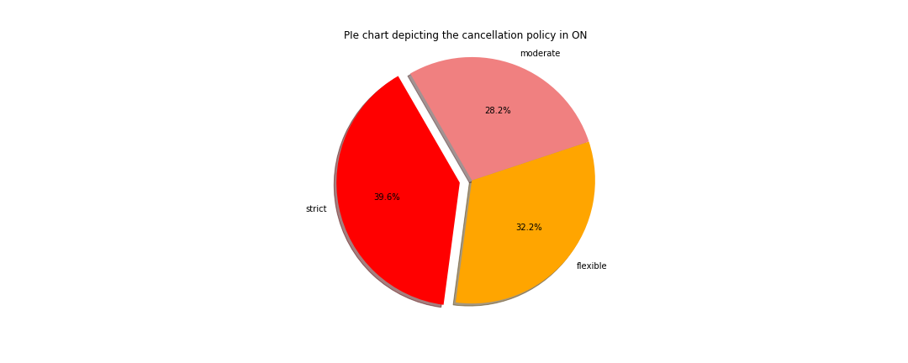
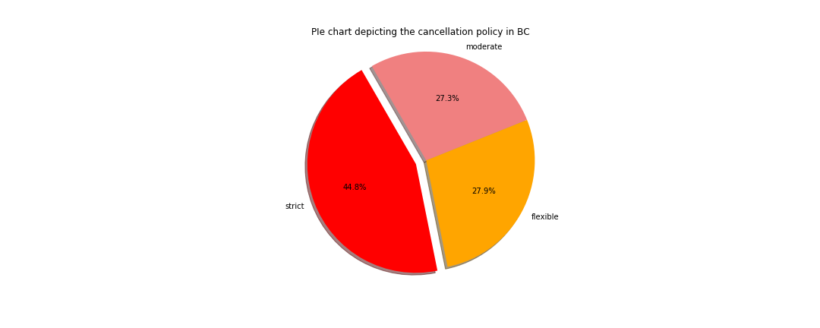

BC
ON
QC
Most of the Listings follow Moderate to Strict Cancellation Policy

Slide 25
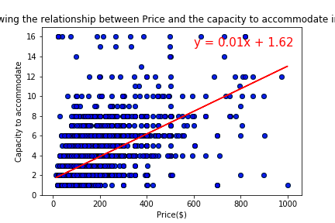
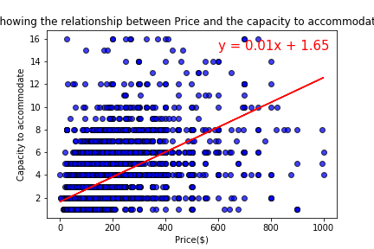
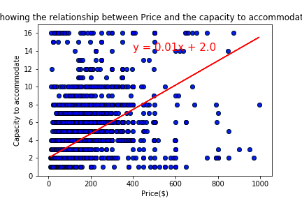
BC
ON
QC
Listing price is positively correlated to the people it can accommodate

Slide 26

Over to Vijay
Over to Vijay

Slide 27
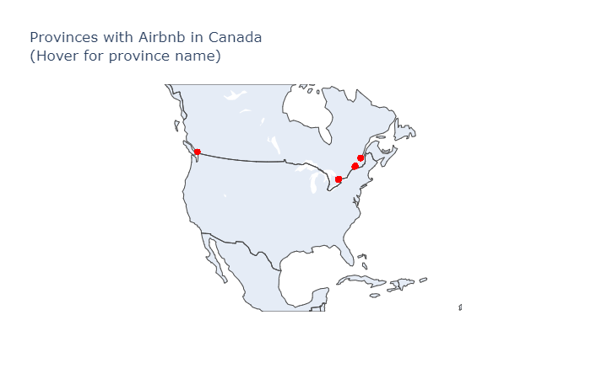
Plot of all the locations of Airbnbs in our Data (Using Plotly)

Slide 28
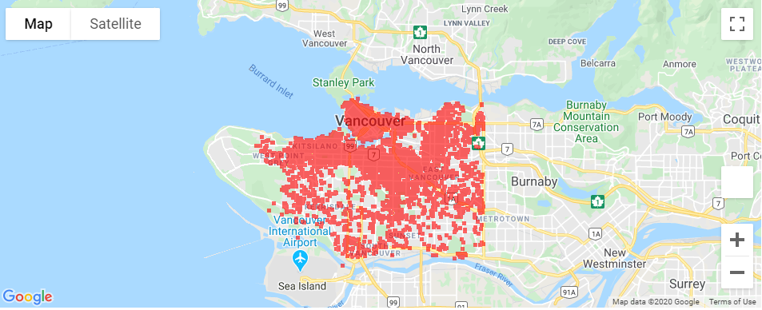
Airbnb Listings Density in BC

Slide 29
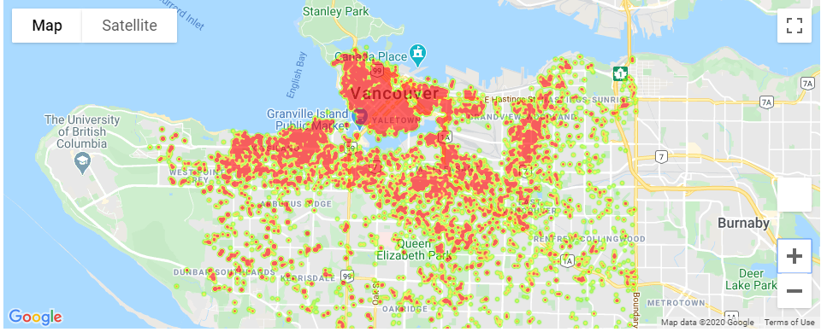
Price Range Heatmap in BC

Slide 30
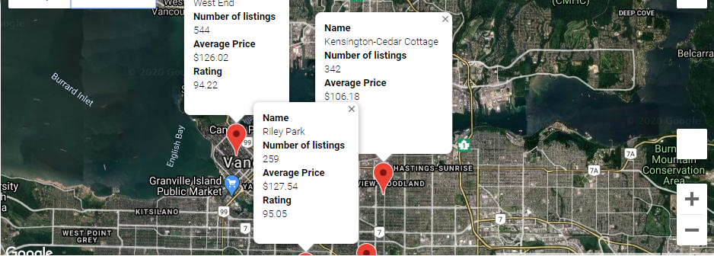
Best Neighbourhoods in BC

Slide 31
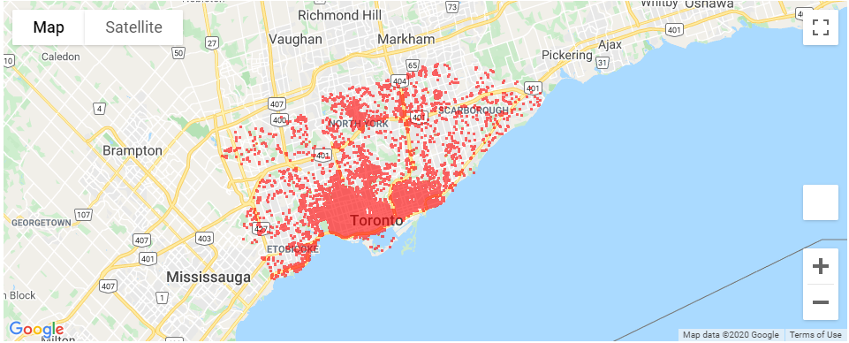
Airbnb Listings Density in ON

Slide 32
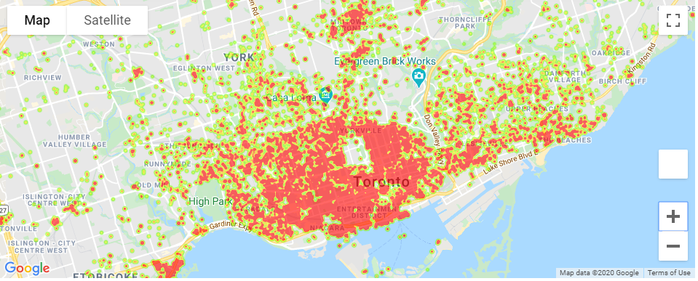
Price Range Heatmap in ON

Slide 33
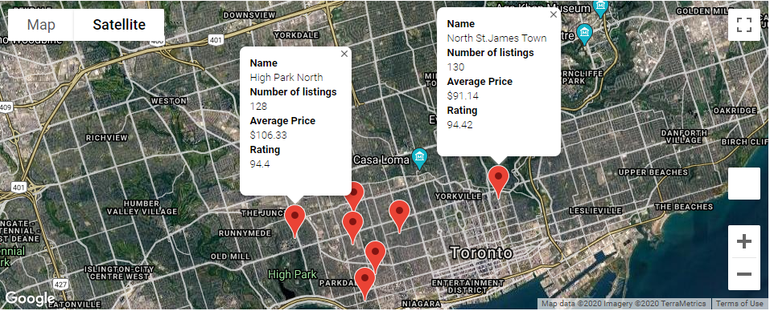
Best Neighbourhoods in ON

Slide 34
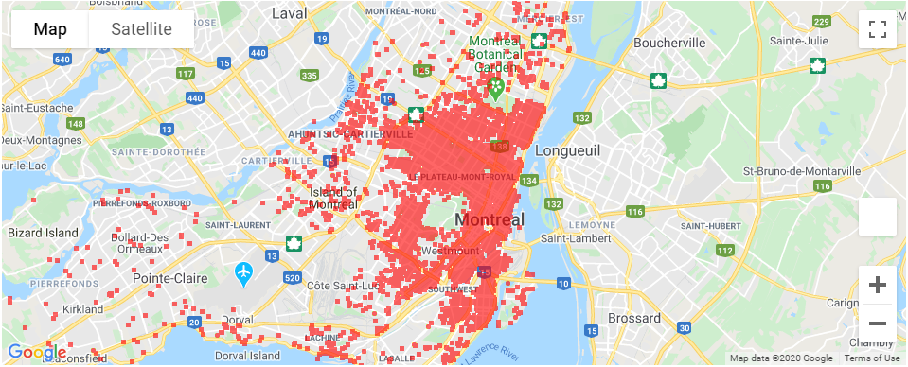
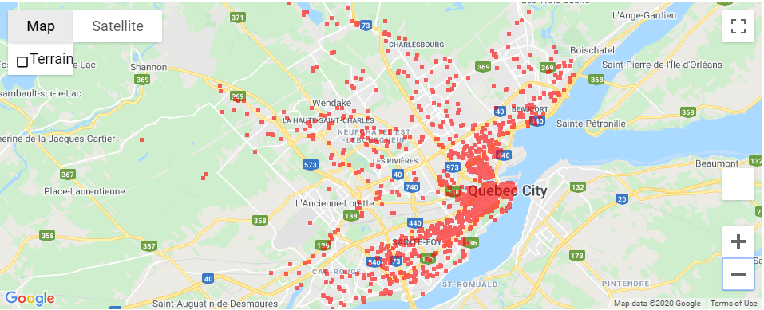
Airbnb Listings Density in QC

Slide 35
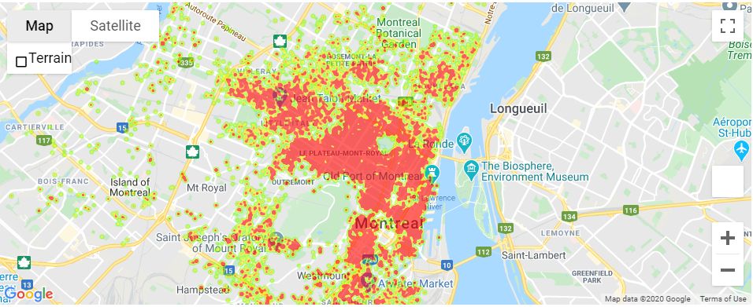
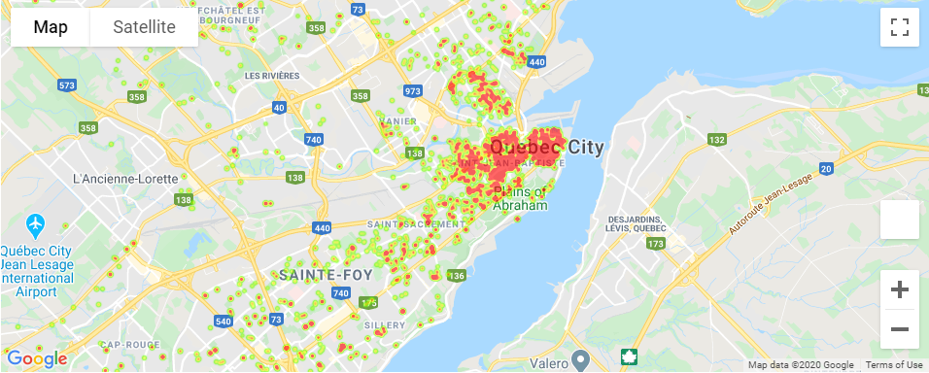
Price Range Heatmap in QC

Slide 36
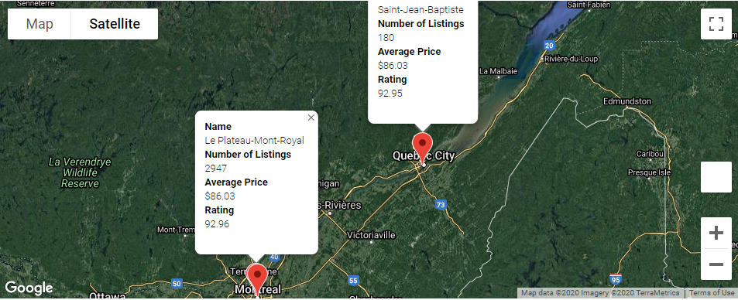
Best Neighbourhoods in QC

Slide 37
Conclusions
Ontario has the most number of Airbnb listings based on our data.
BC has the highest average price per listing.
More than 80% of listings are in Eastern part of Canada than the rest.With around 70% less price compared to British Columbia and Ontario; Quebec has cheapest rents.
BC prices are higher than other 2 states. Probable Reason:
Property rates in British Columbia's are much higher than Ontario and Quebec
Number of listings are lower than other 2 provinces. One of the reasons might be because of strict new regulations about renting out using Airbnb.
Based on our analysis; Toronto, Ontario is likely to have more options based on price, availability and reliability.
We have taken # of reviews as proxy to demand of Airbnb, because that data was not available. The demand of properties in BC are higher than other 2 states.

Slide 38

Future scope
Data for rest of the provinces
Data on how many times a listing was booked, whether it was booked by a tourist or business traveller
Analysis to determine how amenities affect price
Does proximity to public transportation impact the pricing and the demand for the rental
Distance between the property and places of interest
Impact of Airbnb on rental market, hotel pricing and tourism

Slide 39

Tools and Libraries Used
Tools
Python
Jupyter Notebook
Github
Library
Pandas
Matplotlib
IPython.display
Plotly
Numpy
datetime
gmaps

Slide 40

References And Sources
Public Opendatasoft for the data. https://public.opendatasoft.com/explore/?sort=modified
Wikipedia for all the information regarding Airbnb https://en.wikipedia.org/wiki/Airbnb
TowardsDataScience.com for the articles on how to prepare animated graphs. https://towardsdatascience.com/bar-chart-race-in-python-with-matplotlib-8e687a5c8a41
And Google!!!

Slide 41


Slide 42

Questions

